Slide 1

Horizon View Properties: Retirement Housing Outreach
Data Science Representatives : Matthew Barton Tapas Das Robert Dawson Hamad Nasoordeen Leonard Newman

Slide 2

Our Focus
Become the most influential premiere retirement housing community for the baby-boomer generation in the country (USA)

Slide 3
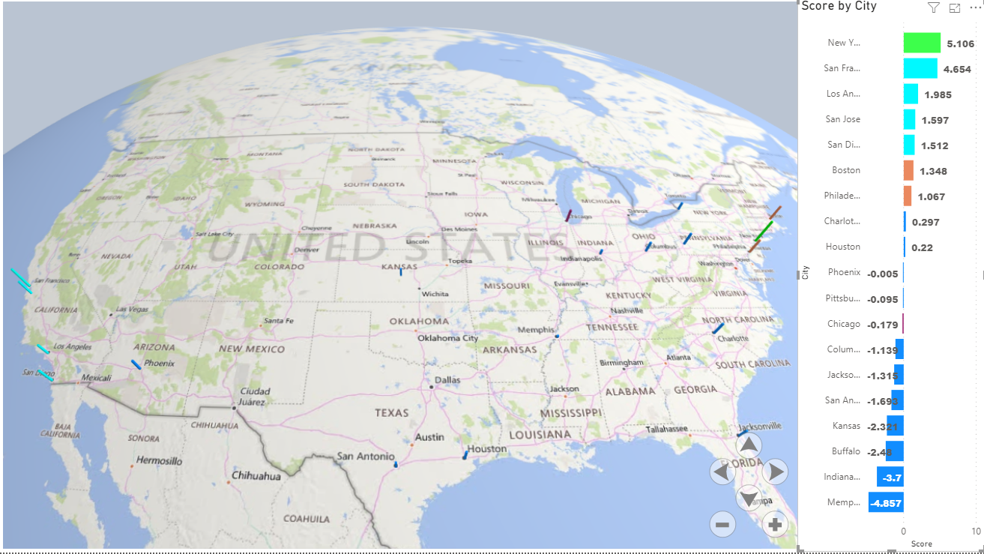
Executive Summary – Recommendation
Notes:
Based on our analysis, we conducted the following major cities with the most populated baby boomers to following groups:
Group 1: Phoenix, Jacksonville, San Antonio and Houston
Group 2: Indianapolis, Buffalo, Columbus, Kansas, Pittsburgh, and Memphis
Group 3 – Los Angeles, San Diego, San Jose
Group 4-Chicago, Philadelphia, and Boston
Group 5: San Francisco and New York.
Each major city was assigned a composite score that correlates to the desirability/potential for each of the areas. New York is the most desirable city, then San Francisco then follow by Los Angeles.

Slide 4
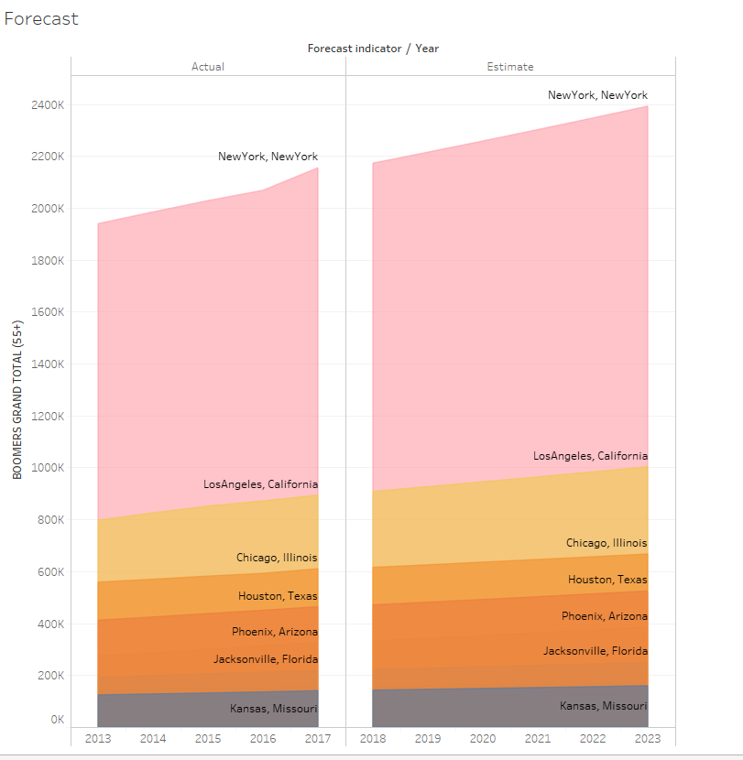
City Forecast Baby Boomers (55+) Population
Notes:
Here is an idea of how much the baby boomer population will continue to grow in the next 5 years. For example, New York Baby Boomer population will grow from 2.2 Million to 2.4 Million, which is a 10% increase in the next 5 years.

Slide 5

Business Analytical Strategy Data Science Team
We will be collecting data for all the top 19 cities cross all regions in the USA (West, Midwest, South, Northeast) with the most populated baby boomers (55+), and perform an analytical analysis on pinpointing the best cities for Horizon View Properties to strategize a plan on where to start building Retirement Housing for the Baby Boomer population.
Data Science Strategy:
Cluster observations
Categorical
Hierarchical
Data reduction techniques
Factor Analysis
Location desirability base off of composite score
We will present the board with a “Composite Score” based on the data collected which will allow them to decipher on which the data suggest which cities will be the most desirable for investment.

Slide 6

Key Attributes
Weather Data
Health Indicators
Affordability/Cost of Living
Median Income
Recreation
Crime rate
Notes:
Here are the key attributes of the different data types that our target audience may consider when finding a location to live.

Slide 7
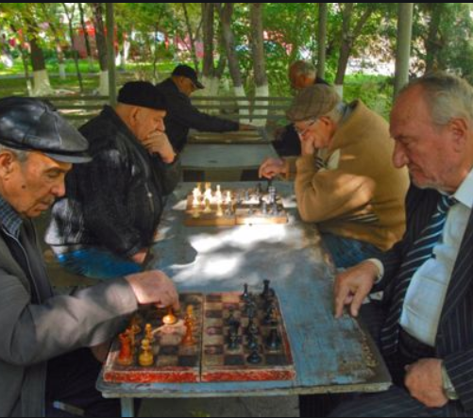
Major Considerations for Retiree Housing Choices
80% of adults 50+ believe its extremely or very important to have:
Safe parks
Well-maintained streets, hospitals, and healthcare facilities
Conveniently located grocery stores (AARP 2018 Retirement Survey)
80% of retirees say it is important to live in a desirable/ preferred climate
80% of retirees say it is important to live near parks for opportunities to enjoy nature/scenery (Housing Retirement Survey, 2017)
75% of adult consumers report that low crime was a very important or mandatory consideration for moving (2017 Senior Living Survey)

Slide 8
Top Divisions/Cities With Baby Boomers (55+)
YEAR | Region | State | City | BOOMER TOTAL (55+) FEMALE | BOOMER TOTAL (55+) MALE | BOOMER TOTAL (55+)
2017 | NORTHEAST | Massachusetts | Boston | 78208 | 62048 | 140256
2017 | NORTHEAST | New York | Buffalo | 35402 | 27633 | 63035
2017 | SOUTH | North Carolina | Charlotte | 92525 | 72642 | 165167
2017 | MIDWEST | Illinois | Chicago | 339676 | 270143 | 609819
2017 | MIDWEST | Ohio | Columbus | 96104 | 74991 | 171095
2017 | SOUTH | Texas | Houston | 250345 | 213441 | 463786
2017 | MIDWEST | Indiana | Indianapolis | 112551 | 89791 | 202342
2017 | SOUTH | Florida | Jacksonville | 120705 | 97005 | 217710
2017 | MIDWEST | Missouri | Kansas | 63746 | 52554 | 116300
2017 | WEST | California | Los Angeles | 490583 | 403108 | 893691
2017 | SOUTH | Tennessee | Memphis | 89467 | 66608 | 156075
2017 | NORTHEAST | New York | New York | 1222994 | 931246 | 2154240
2017 | NORTHEAST | Pennsylvania | Philadelphia | 220505 | 162439 | 382944
2017 | WEST | Arizona | Phoenix | 172053 | 151140 | 323193
2017 | NORTHEAST | Pennsylvania | Pittsburgh | 45058 | 34477 | 79535
2017 | TEXAS | Texas | San Antonio | 179263 | 144644 | 323907
2017 | WEST | California | San Diego | 170551 | 146902 | 317453
2017 | WEST | California | San Francisco | 120591 | 110106 | 230697
2017 | WEST | California | San Jose | 127710 | 111412 | 239122
Notes:
Based of the 2017 census, we have found the top major cities with the most populated Baby Boomer sub group (55+) to be included in the analysis and verify how the key attributes will influence the investment decision.

Slide 9
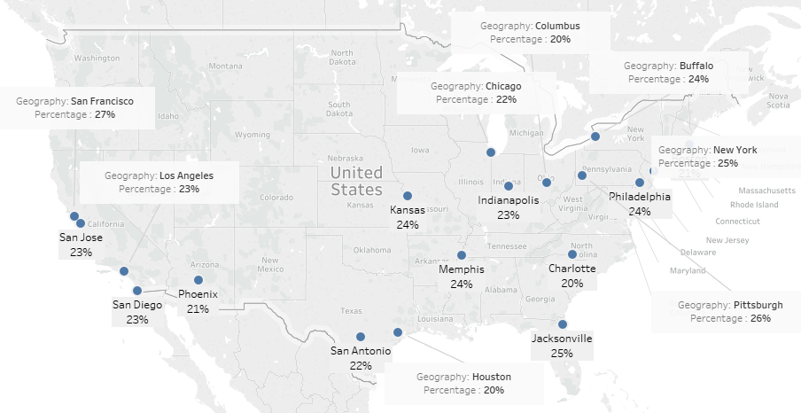
Retirement Home Outreach
Notes:
Here is a geographical map that shows the percentage group of baby boomers for each major city. As you can see across the map, Baby Boomer sub group (55+) take around 20-25% of the population.

Slide 10
Baby Boomers Major Cities Variables
State | City | Violent Crime Rate per 100,000 people | BOOMER TOTAL (55+) FEMALE | BOOMER TOTAL (55+) MALE | BOOMER TOTAL (55+) | Cost of Living Index | Rent Index | Cost of Living Plus Rent Index | Groceries Index | Restaurant Price Index | Local Purchasing Power Index | Total Outdoor Recreation Value Added (Thousands of Dollars) | Park Acres % of City | People per Park Acre | Total Health Index | Healthcare rank | Food Rank | Fitness Rank | Greenspace Rank | Per capita personal income | Weather-Clear Days | Weather-Summer comfort | Weather-Avg High | Weather- Avg Low | Cultural Diversity Index
New York | New York | 539 | 1222994 | 931246 | 2154240 | 100 | 100 | 100 | 100 | 100 | 100 | $26,299,866 | 20.58% | 214.9573747 | 62.79 | 70 | 2 | 20 | 14 | 65,284.00 | 107 | 6.9 | 62 | 48 | 69.4
California | San Francisco | 715 | 120591 | 110106 | 230697 | 99.14 | 125.79 | 111.92 | 110.16 | 91.99 | 96.76 | $52,120,252 | 19.63% | 143.9497283 | 73.29 | 24 | 1 | 10 | 1 | 82,523.00 | 160 | 7.6 | 64 | 51 | 66.4
California | Los Angeles | 761 | 490583 | 403108 | 893691 | 80.67 | 68.11 | 74.65 | 76.53 | 82.39 | 124.27 | $52,120,252 | 12.47% | 105.2773961 | 60.3 | 68 | 4 | 12 | 38 | 56,749.00 | 147 | 8.1 | 75 | 56 | 65.15
California | San Jose | 403.65 | 127710 | 111412 | 239122 | 82.75 | 85.35 | 83.99 | 84.96 | 79.15 | 152.9 | $52,120,252 | 14.24% | 63.24103202 | 57.11 | 23 | 11 | 29 | 54 | 84,960.00 |  | 7.8 | 71 | 50 | 68.5
California | San Diego | 366.61 | 170551 | 146902 | 317453 | 77.93 | 61.54 | 70.08 | 77.09 | 77.42 | 128.92 | $52,120,252 | 22.98% | 28.66440806 | 67.62 | 33 | 3 | 3 | 7 | 54,742.00 | 146 | 8 | 70 | 58 | 65.6
Massachusetts | Boston | 669 | 78208 | 62048 | 140256 | 89.4 | 77.51 | 83.7 | 90.68 | 90.96 | 131.75 | $9,210,427 | 16.48% | 127.282741 | 57.44 | 41 | 20 | 24 | 20 | 69,391.00 | 98 | 6.9 | 59 | 44 | 65.53
Pennsylvania | Philadelphia | 948 | 220505 | 162439 | 382944 | 86.35 | 51.39 | 69.59 | 89.52 | 76.21 | 129.65 | $13,173,567 | 12.62% | 145.1394275 | 54.58 | 147 | 13 | 40 | 21 | 57,906.00 | 93 | 6.3 | 65 | 47 | 55.6
North Carolina | Charlotte | 416 | 92525 | 72642 | 165167 | 75.85 | 40.15 | 58.74 | 77.42 | 72.48 | 117.9 | $11,936,052 | 4.17% | 74.49035025 | 49.53 | 51 | 53 | 31 | 106 | 46,713.00 | 109 | 4.9 | 71 | 49 | 58.4
Texas | Houston | 1059 | 250345 | 213441 | 463786 | 75.4 | 45.59 | 61.11 | 73.66 | 77.51 | 150.24 | $34,565,594 | 13.85% | 42.69008544 | 60.05 | 72 | 12 | 19 | 10 | 54,322.00 | 90 | 2.7 | 80 | 60 | 64.2
Arizona | Phoenix | 760.9 | 172053 | 151140 | 323193 | 69.08 | 31.76 | 51.2 | 61.46 | 75.44 | 146.53 | $8,654,150 | 14.89% | 31.58393227 | 50.56 | 98 | 31 | 72 | 39 | 41,624.00 | 211 | 4.9 | 87 | 63 | 60.66
Pennsylvania | Pittsburgh | 656 | 45058 | 34477 | 79535 | 82.96 | 38.74 | 61.77 | 84.26 | 75.85 | 146.69 | $13,173,567 | 10.39% | 83.92913386 | 54.23 | 26 | 21 | 43 | 58 | 51,130.00 | 59 | 6.5 | 61 | 42 | 41.2
Illinois | Chicago | 1098.86 | 339676 | 270143 | 609819 | 84.51 | 58.68 | 72.13 | 80.88 | 82.58 | 122.99 | $14,725,840 | 8.87% | 214.6285515 | 42.77 | 89 | 71 | 147 | 98 | 55,384.00 | 84 | 6.7 | 59 | 41 | 63.1
Ohio | Columbus | 264.9 | 96104 | 74991 | 171095 | 71.63 | 30.86 | 52.09 | 78.55 | 63.75 | 84.28 | $10,167,019 | 10.90% | 55.67344111 | 48.3 | 131 | 33 | 38 | 94 | 47,413.00 | 72 | 5.8 | 63 | 44 | 47.6
Florida | Jacksonville | 899 | 120705 | 97005 | 217710 | 77.31 | 32.07 | 55.63 | 80.12 | 74.92 | 112.56 | $42,183,230 | 13.51% | 13.42394316 | 44.41 | 132 | 80 | 89 | 76 | 45,102.00 | 94 | 4 | 79 | 58 | 51.9
Texas | San Antonio | 707 | 179263 | 144644 | 323907 | 62.5 | 35.03 | 49.33 | 60.74 | 59.96 | 136.57 | $34,565,594 | 10.07% | 47.73555166 | 44.52 | 127 | 78 | 81 | 88 | 43,487.00 | 105 | 3.8 | 80 | 59 | 52.5
Missouri | Kansas | 413 | 63746 | 52554 | 116300 | 69.09 | 29 | 49.88 | 66.65 | 70.36 | 156.57 | $6,761,351 | 8.77% | 27.10891817 | 43.9 | 97 | 86 | 124 | 81 | 49,401.00 | 120 | 4.9 | 66 | 48 | 48.03
New York | Buffalo | 1019 | 35402 | 27633 | 63035 | 73.69 | 28.89 | 52.22 | 74.14 | 66.34 | 115.19 | $26,299,866 | 7.40% | 136.0935703 | 45.8 | 63 | 76 | 128 | 68 | 45,362.00 | 54 | 7.4 | 56 | 40 | 50.55
Indiana | Indianapolis | 1333.96 | 112551 | 89791 | 202342 | 76.13 | 30.79 | 54.4 | 79.48 | 67.08 | 94.08 | $9,658,524 | 4.96% | 74.35275645 | 40.76 | 161 | 98 | 112 | 105 | 48,948.00 | 88 | 6 | 63 | 44 | 46.7
Tennessee | Memphis | 2003 | 89467 | 66608 | 156075 | 78.8 | 28.82 | 54.19 | 84.63 | 73.14 | 125.81 | $7,342,537 | 4.54% | 72.90574084 | 31.07 | 165 | 155 | 164 | 159 | 42,588.00 | 102 | 4.3 | 73 | 54 | 40.8
Notes:
After researching all the main key attributes, we collected the following 24 variables to perform the data analysis for each populated Baby Boomer City. Just to name a few, Violent Crime Rate, Cost of Living Index, Total Outdoor Recreation value, Healthcare, and Weather – Avg High.

Slide 11
Data Source Reference
Baby Boomer (Age: 55+)
https://factfinder.census.gov/faces/nav/jsf/pages/searchresults.xhtml?refresh=t
Provides the census count of individuals(Male and Female) who were older than or equal to 55 of age for each city in United States.
Note: This Dataset shares the most populated baby boomers for each region in United States. We had chosen the top cities for each region in the United States for us to plan out our strategy on the recommendation on where to start building for our Retirement Housing Outreach project.
Cost of Living Index (w/Rent)
https://www.numbeo.com/cost-of-living/rankings.jsp
Is a relative indicator of consumer goods prices, including groceries, restaurants, transportation, utilities, and rent.
Notes: This dataset will help us get an idea of how much the living expenses will cost for our retirees to settle in this area. The CPI will also help us determine how much the monthly or annual cost should be for that particular area for our retirees.
Outdoor Recreation in 2017 measured by economic activity
https://www.bea.gov/data/special-topics/outdoor-recreation Measures the economic activity as well as the sales or receipts generated by outdoor recreational activities, such as fishing and RVing. These statistics also measure each industry’s production of outdoor goods and services and its contribution to U.S. GDP. Industry breakdowns of outdoor employment and compensation are also included.
Park data
https://www.tpl.org/sites/default/files/files_upload/CityParkFacts_2017.4_7_17.FIN_.LO_.pdf Includes various statistics about parks for different cities.
Notes: These 2 data sources will allow us to examine the areas with the most active use outdoor recreation on public lands and in common spaces. We can then use this data to promote our location as a retirement hotspot for our clients who enjoy nature and outdoor activities.
Notes:
Here are the sources that we used to collect the data variables for our analysis.

Slide 12
Data Source Reference
Total Health Index
https://wallethub.com/edu/healthiest-cities/31072/
To determine which areas prioritize residents’ well-being, the Total Health index correlates the ranking score for Health Care, Food, Fitness, and Green Space within each city.
Notes: This dataset will provide the cities health environment indicators that we can share to the board for further reasoning to why this particular location will be great for our retirees.
per capita personal income
https://www.bea.gov/data/income-saving/personal-income-county-metro-and-other-areas
Is the income that is received by persons from all sources
Notes: The dataset will assist us on analyzing the average wealth of each individual income for each metropolitan area.
Crime Rate
https://ucr.fbi.gov/crime-in-the-u.s/2017/crime-in-the-u.s.-2017/topic-pages/tables/table-6
2017 Violent Crime Rate per 100,000 people in US Cities
https://ucr.fbi.gov/crime-in-the-u.s/2017/crime-in-the-u.s.-2017/topic-pages/tables/table-4
Notes: This information is taken from FBI tables for violent crime rates for regions/ US cities. Multiple types of crime reports are available, including violent crime, property crime, homicides, and more.

Slide 13
Analysis Approach
Collected Data thru various online sources.
Clean Data (narrowed down based on highest baby boomer pop. cities in different regions)
Standardize data
Perform following analyses:
Principle Component Analysis
ANOVA Analysis of Variance
Factor Analysis
Hierarchical Cluster Analysis (aka Dendrogram)
Composite score based on Crime Rate, Cost of Living, People per Park Acre, Total Health Index, Weather
Notes:
Choosing suggested markets based on similarity to LA/SoCal

Slide 14
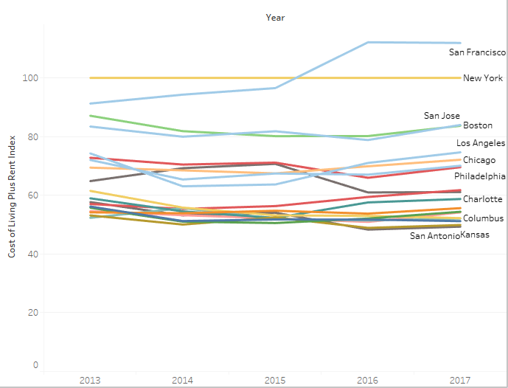
Cost of Living Trend
Notes:
Here is the cost of living trend for each major city (2013-2017). As you can see, San Francisco is ranked the highest, while San Antonio is ranked the lowest.

Slide 15
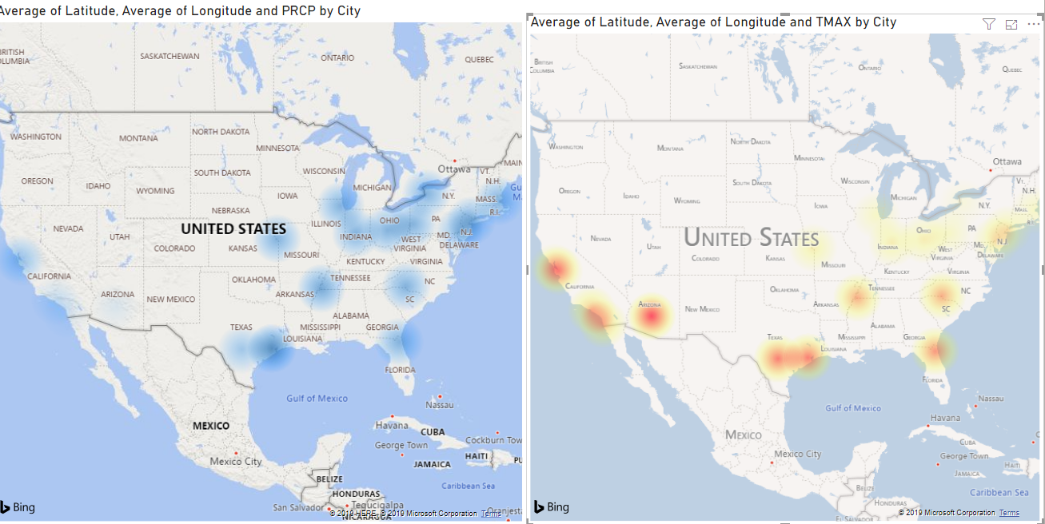
Weather view of Target Cities
Notes:
Here is an overview of the average heat and average precipitation for each major city.

Slide 16
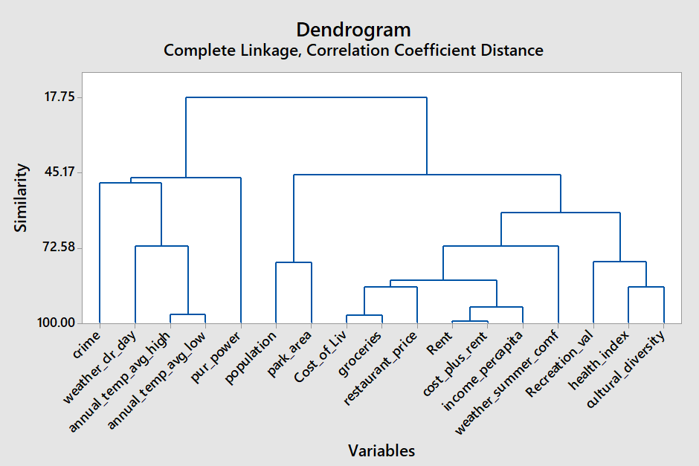
Cluster Dendrogram - Variables
Notes:
Performing the hierarchical cluster analysis for the variables collected for each major city, will gives an overview on how each variable share a similar correlation. As you can see from the dendrogram, it had grouped up all our variables that we had collected for each major city, and gives us nice big pictures on how each variable can be similar to each other. If you would insert a straight line through the highest horizontal line (Euclidean distance), 2 clusters will be defined that show which variables had the closest coefficients amongst each other. However, by lowering the Euclidean Distance line to get the next group of clusters (4 Clusters), you can see how it makes sense how some of the variables would be clustered together. For example, Cost_of_living, Groceries, restaurant_price, Rent, Cost_plust_rent, income_percaptial, would share a similar cluster since those variables tend to relate to the different expenses that an individual would encounter being in a major city. However, reviewing the next set of clusters that have Crime, Weather_dr_day, annual_temp_avg_high, annual_temp_avg_lowm pur_power grouped as one, will give you a hypothetical theory how Crime rate would be related to the temperature that is involved with the city, which may be the case for a crime to occur depending on the weather. Also, using this analysis can help us to reduce the number of variables that are needed for our analysis, which is similar to the Factor Analysis and Principal Component analysis.

Slide 17
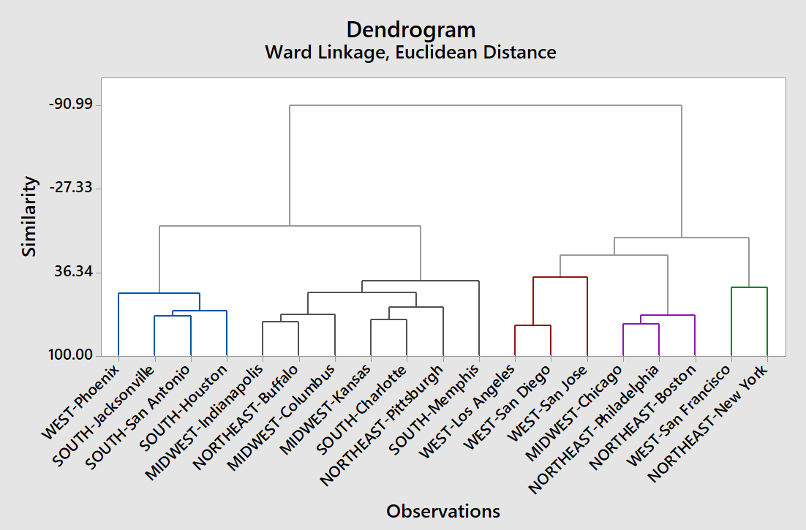
Cluster Dendrogram – Major Cities
Notes:
In this dendrogram, it has clustered out all of the top baby boomer major cities into their respected group by pinpointing which cities had similar attributes amongst each other. As you can see, we generated 5 different clusters from our overall city selection which can provide us a strategy on which major cities to start building out the different phases for our Retirement Housing Outreach project. This analysis was based on using the Hierarchical Cluster Analysis where we had indexed our variables that we had collected for each major city and were able to generate the clustering groups which are based off on which cities variables had a close linkage, coefficient value distance amongst each other. If we would consider this clustering group, we would have - Group 1: Phoenix, Jacksonville, San Antonio and Houston, Group 2: Indianapolis, Buffalo, Columbus, Kansas, Pittsburgh, and Memphis, Group 3 – Los Angeles, San Diego, San Jose, Group 4-Chicago, Philadelphia, and Boston, and then Group 5: San Francisco and New York.

Slide 18
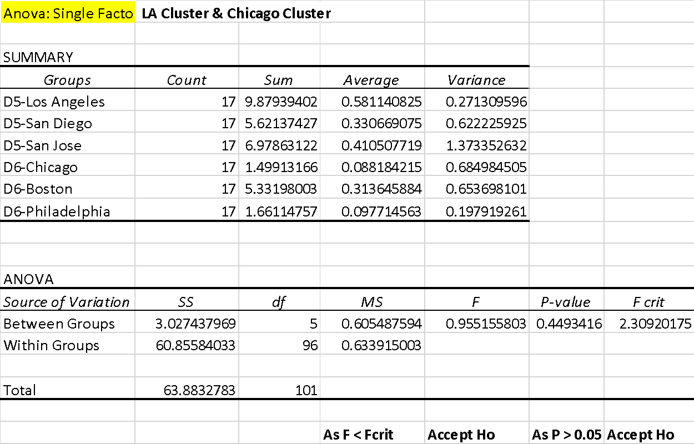
ANOVA

Slide 19

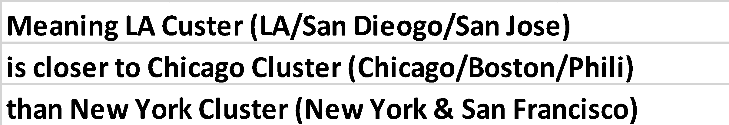
ANOVA (cont’d)
Notes:
Analysis of variance (ANOVA) is used to determine whether there are any statistically significant differences between the means of three or more independent (unrelated) groups. We used ANOVA analysis to determine which cluster of cities are similar to Southern California Cluster (LA/San Diego). Based on the ANOVA analysis, LA cluster (LA/San Dieogo/San Jose)is closer to Chicago Cluster (Chicago/Boston/Phili) than New York Cluster (New York & San Francisco). P > 0.05 for Chicago Cluster, but P < 0.05 for New York Cluster.

Slide 20
Factor Analysis
Notes:
Factor Analysis Explanation: Factor analysis only works if number of variables is less than number of observations. So some correlated variables had to be removed. Large (positive or negative) rotated factor loadings indicate that the factor has a strong influence on the variable. The following variables had the most impact (either x > 0.7 or x < -0.7):
Factor1 - Total Health Index, Food Rank, Fitness Rank, and Greenspace Rank.
Factor2 - Cost of Living Plus Rent Index, Groceries Index, Restaurant Index, People per Park Acre, and Per capita personal income.
Factor3 - Weather-Clear Days
Factor4 - Weather-Summer comfort Factor5 - Total Outdoor Recreation Value Added
These 5 factors account for 82.1% of the variation in the data.

Slide 21
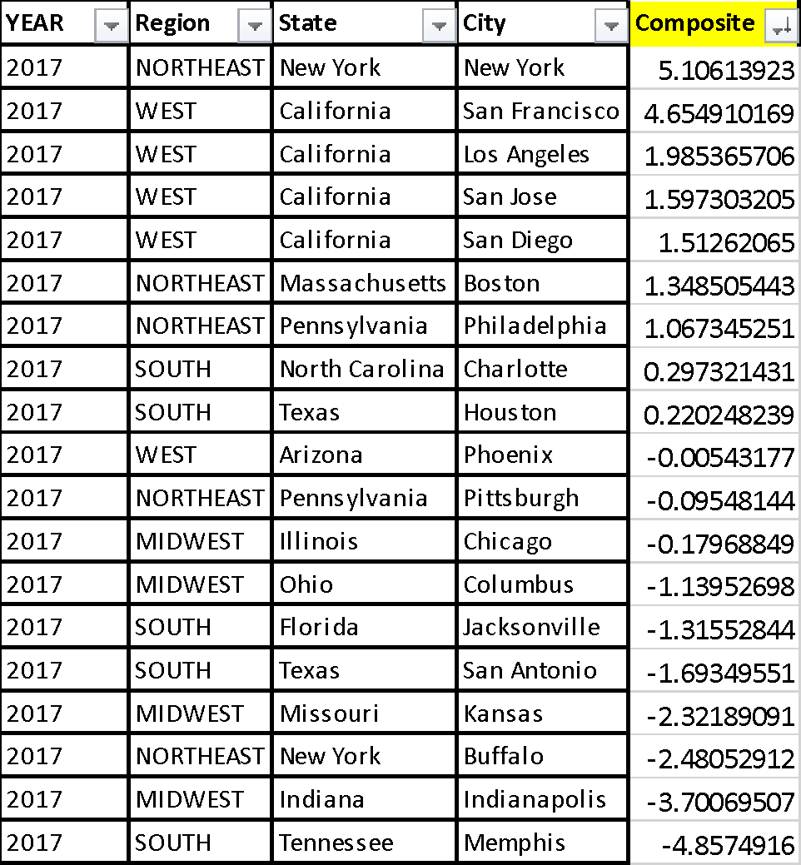
Retirement Outreach Plan: Composite Score
Notes:
The composite score is based off the combination of the following variables: Crime Rate (Per 100,00 persons), Cost of Living, People per Park Acre, Total Health Index, and Weather (High Temperature). The variables were standardized using z-scores to compare the variables from different measures. These variables were
identified from our research, as well as being organized as principal components from the Principal Component Analysis (PCA). This score can be used as way to consider the desirability of a new expansion location given the factors listed above.

Slide 22
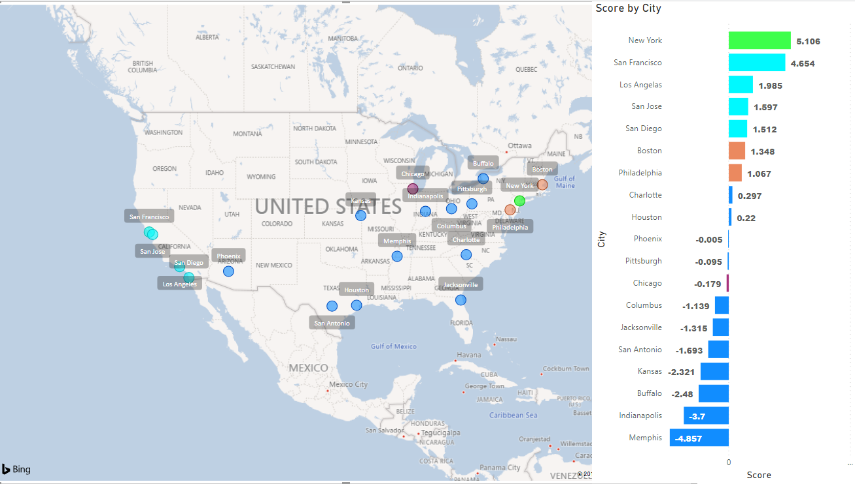
Geographic - Desirability (Composite Score)
Notes:
Composite Score plotted with call outs

